Slide 1
Druga Nedelja Ponedeljak
Made by Tamara Pavlovic for BCS 201 FA23

Slide 2
#Samokažem #Justsaying short episodes + english translation + free Link https://www.youtube.com/watch?v=L_LUTEY11mk&list=PLhabEPxGXH-G3v6rnqZ8rOhUwTF441oVo
Preporuke

Slide 3

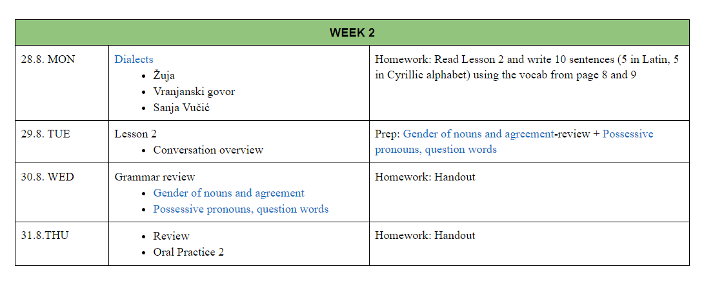

Slide 4
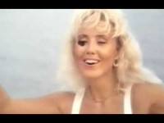
Tekst i prevod https://lyricstranslate.com/en/Jugoslovenka-Yugoslavian.html

Slide 5
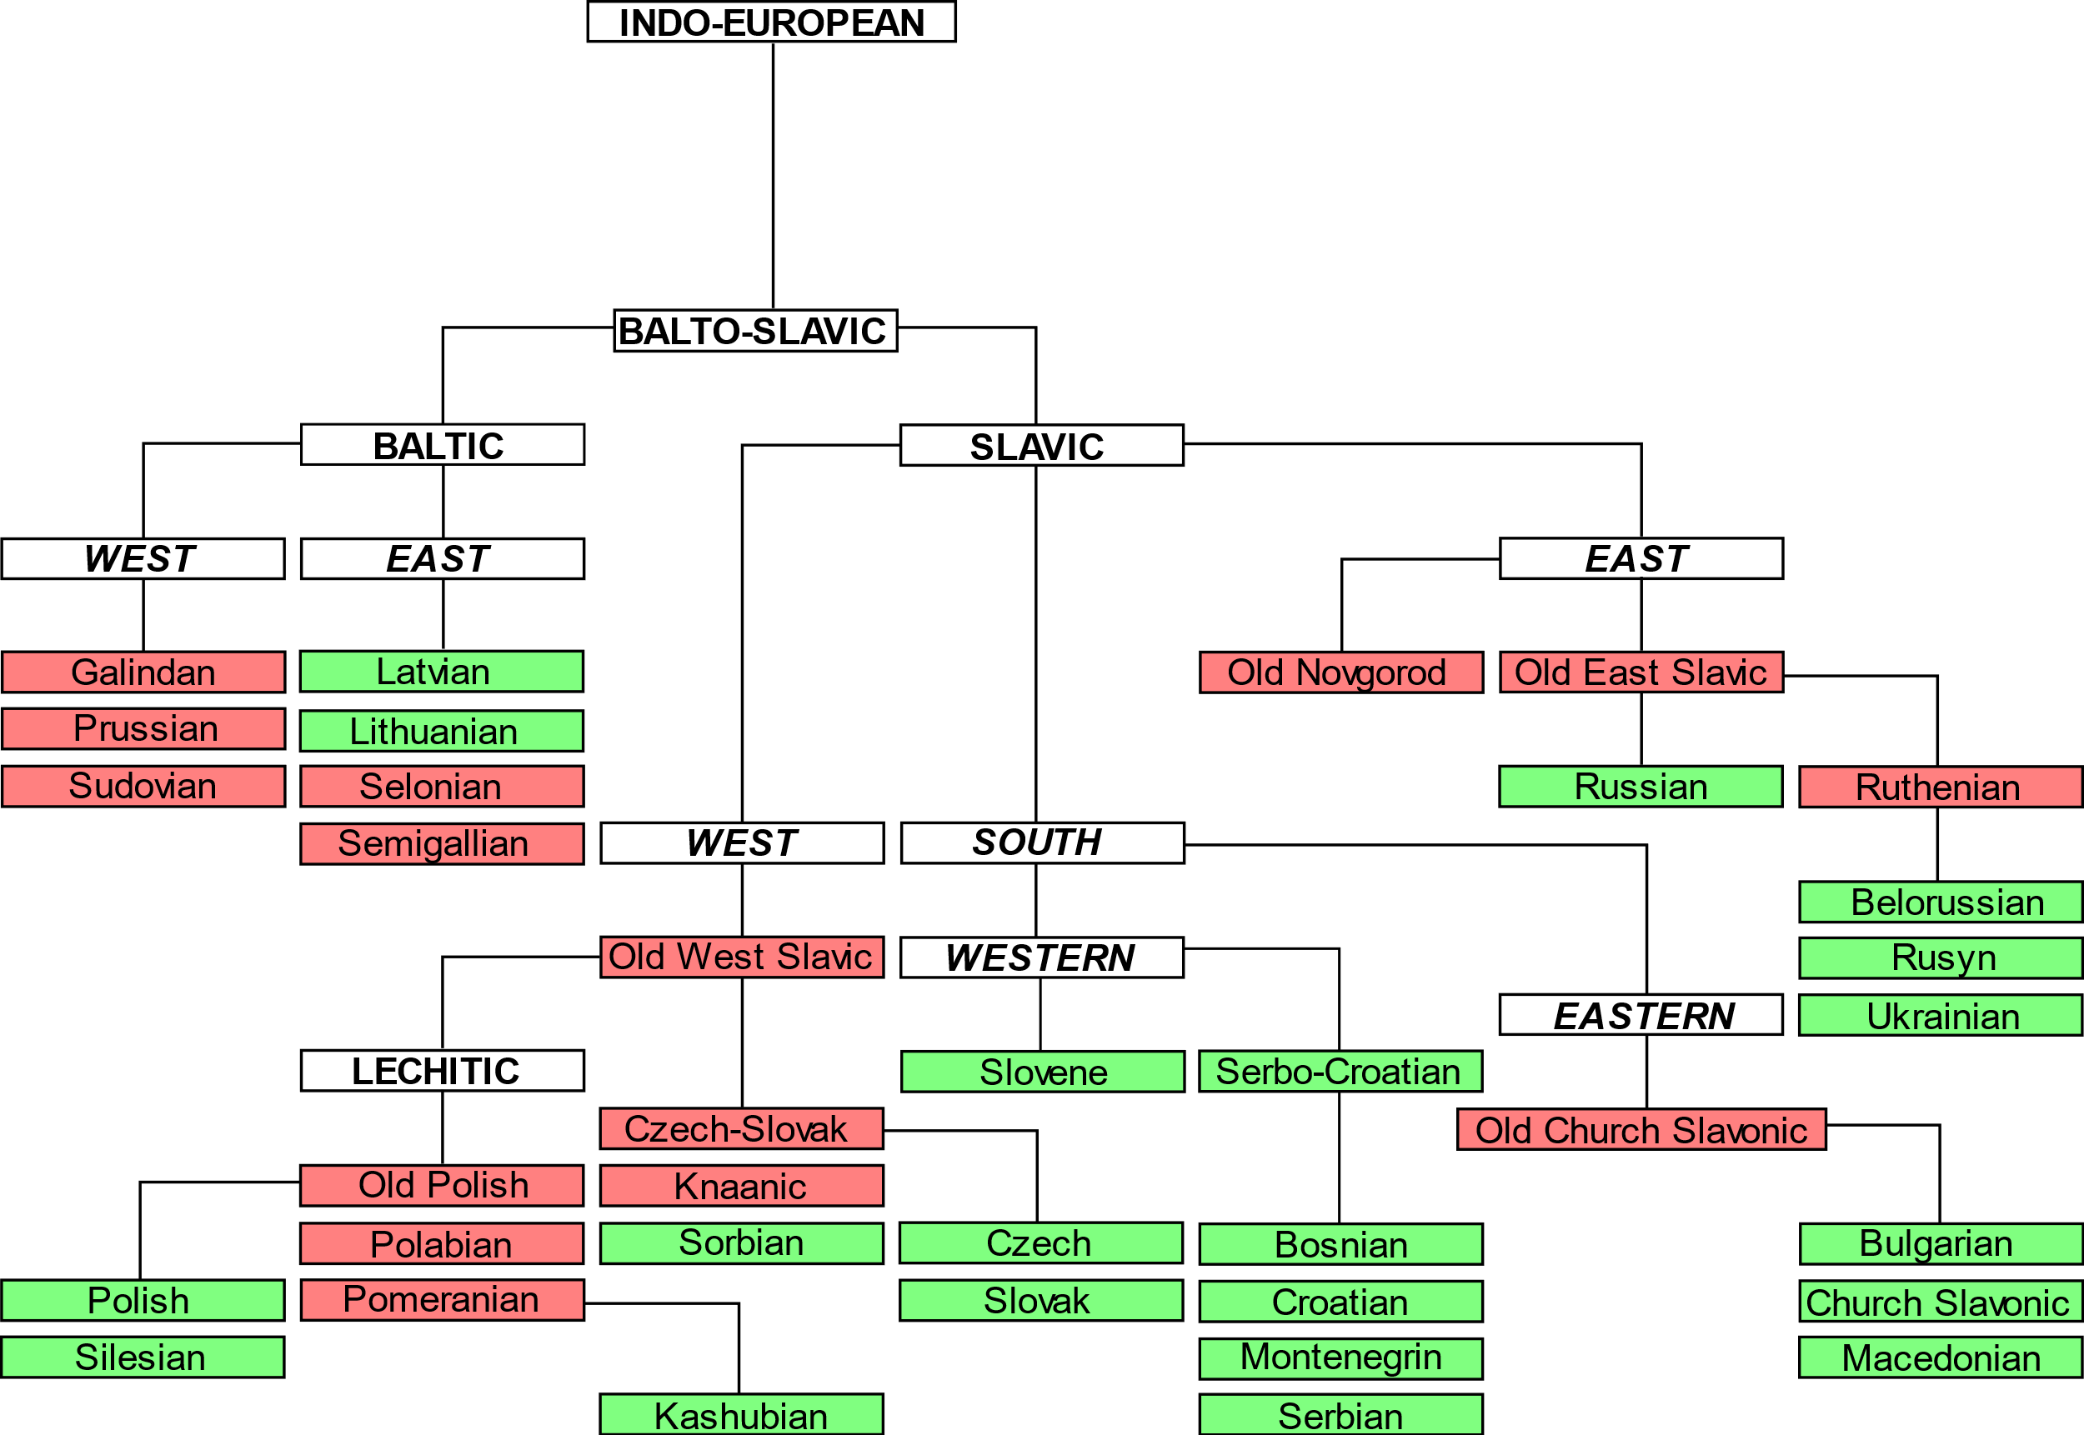

Slide 6
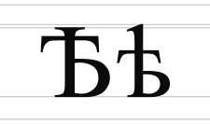
Ekavica i ijekavica
JAT
IJE
JE
I
E
Djevojka/devojka
Reka/rijeka
Svijetlo/svetlo

Slide 7
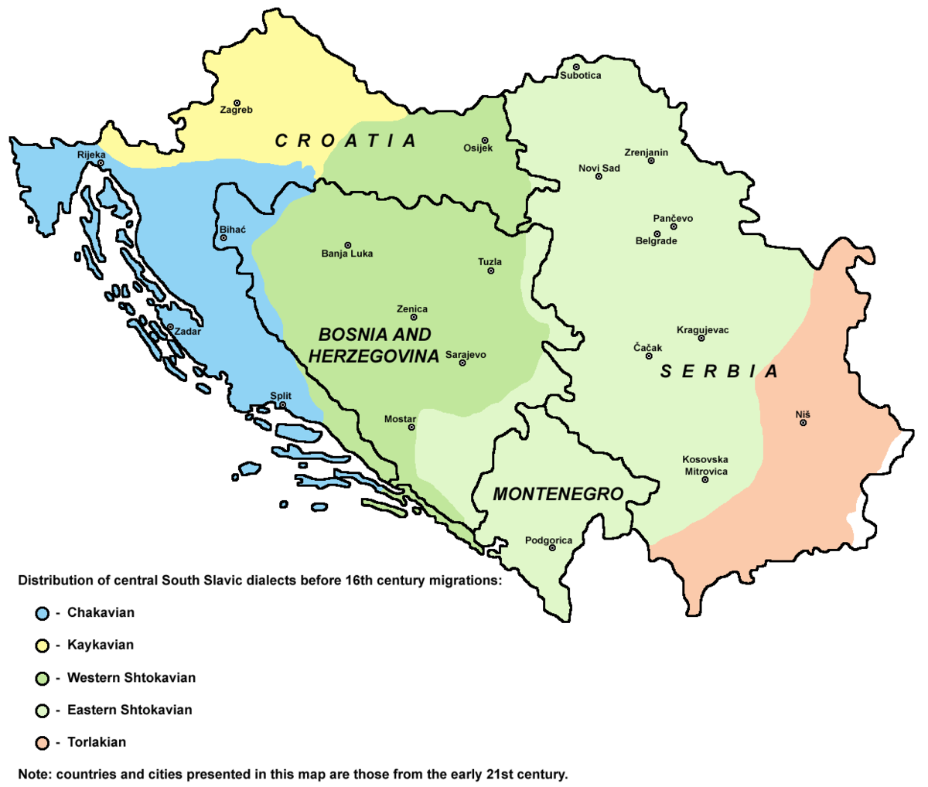
So what? Šta? Što? Kaj? Ča?

Slide 8
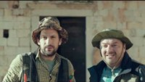
Žuja

Slide 9
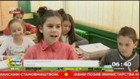
Vranjanski govor

Slide 10
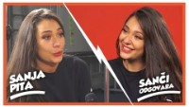
Kruševački

Slide 11

Homework
Read Lesson 2 and write 10 sentences (5 in Latin, 5 in Cyrillic alphabet) using the vocab from page 8 and 9

